Slide 1
Section 7.5 Intersecting Chords
© Copyright all rights reserved to Homework depot: www.BCMath.ca

Slide 2
Review: Similar Triangles
When two triangles are similar, then corresponding sides will have the same ratio

Slide 3
I) Property of Intersecting Chords
In this section, we will explore three properties of intersecting chords

Slide 4
Property of Intersecting Secants:

Slide 5
Property of Tangent and Secant:

Slide 6
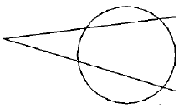
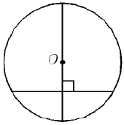
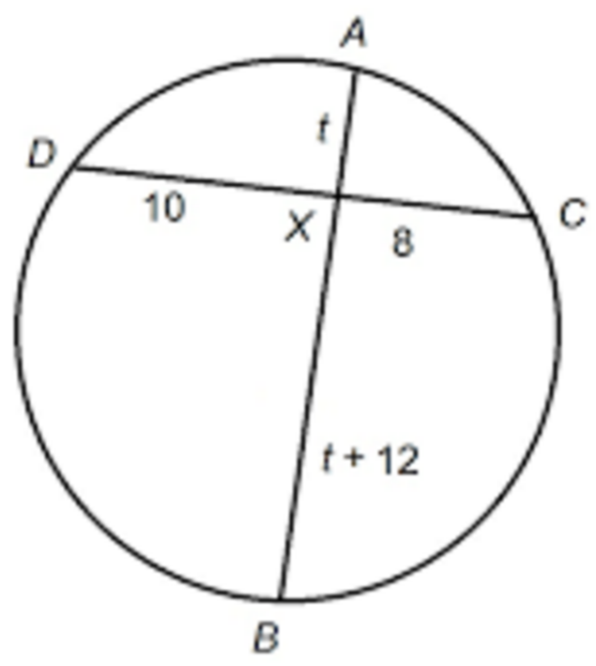
Ex: Solve for “x”:
ANS
ANS
ANS
ANS

Slide 7
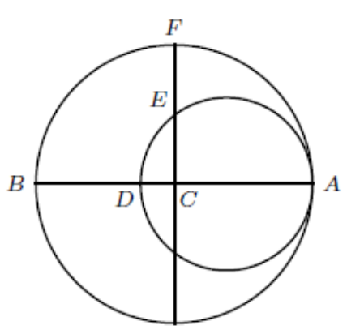
ANS

Slide 8
Ex: In the diagram, O is the centre of the circle with radius “r”. ED = “r” and .What is the value of “k”?

Slide 9
CQ Property #2 (Ptolemy’s Thm)
Given a CQ with sides a,b,c,d and diagonals x,y

Slide 10
Proof For CQ Property #2 (J.Liu’s Proof)
1st step: Draw a line from point “R” to line ‘y”
so that ∕ MRN = ∕ SRT
2ndstep: Find all angles equal to ∕ MRN, or any other angle equal to each other
3rd step: Split “y” to w + z
4th step: Now look for any similar triangles
5th step: Add the two equations

Slide 11
Rewrite the equation to make it easier to prove
Now look for similar triangles by showing which
angles are equal
Now use the formula from the previous slide:

